Slide 1


Artificiële Intelligentie
WORKSHOP CMGT PRG08-2021-2022 14 MAART 2022
Demystifying
Computational Foundations of
Machine Learning [ML]
Deep Learning [DL]
DataLab
Rob van der Willigen

Slide 2


CONTEXT
Prerequisites: basics in linear algebra, probability, and analysis of algorithms.
Workload: Do it your-self assignments

Slide 3
Simple Predicting Machine
WHY DEMISTIFYING AI?

Slide 4
Simple Predicting Machine
“The inescapable resurgence of {AI}
on the world wide web {WWW}
— along with the arrival of Internet-of-Things {IoT} —
has expanded the scope of the
digital world into the realm of cybernetics”
Cybernetics studies communication & control in living beings + the machines built by humans

Slide 5
Simple Predicting Machine
The cybernetic foundation of {AI}
explains its insatiable hunger for
Big data, with the promise to solve
societal challenges ranging from:
Health - Climate Change - Safety
up to Cyber Physical Systems {CPSs}: Robotics & Driverless Cars

Slide 6
Simple Predicting Machine
Today it seems we only
receive ambiguous promises
and paradoxical stories
{AI} has revealed itself to us
as a double-edged sward:
Dangerous yet Supportive
All-Consuming yet Liberating
https://robfvdw.medium.com/the-world-wide-web-ai-safari-b2e4f7f90647

Slide 7
Simple Predicting Machine
{AI} is dominated by
labour intensive,
wasteful & costly
Brute-Force practices

Slide 8
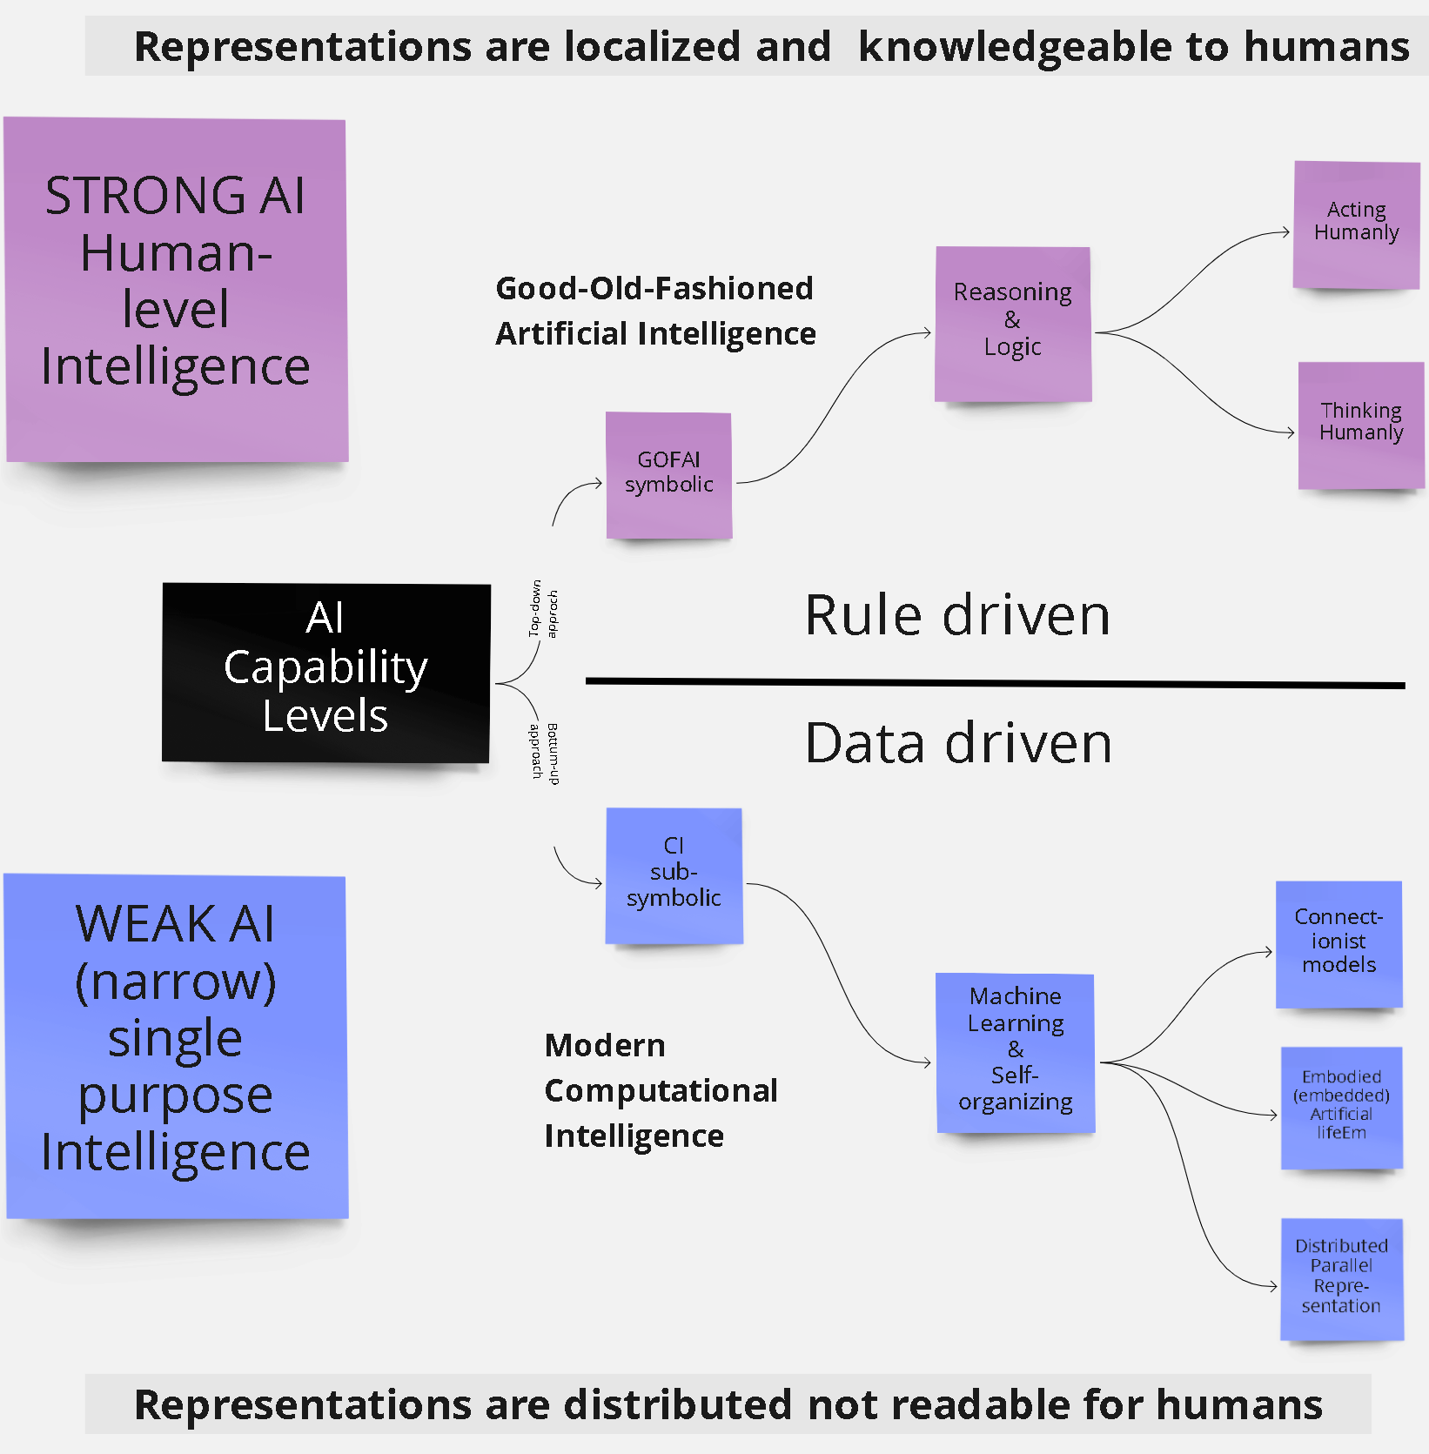
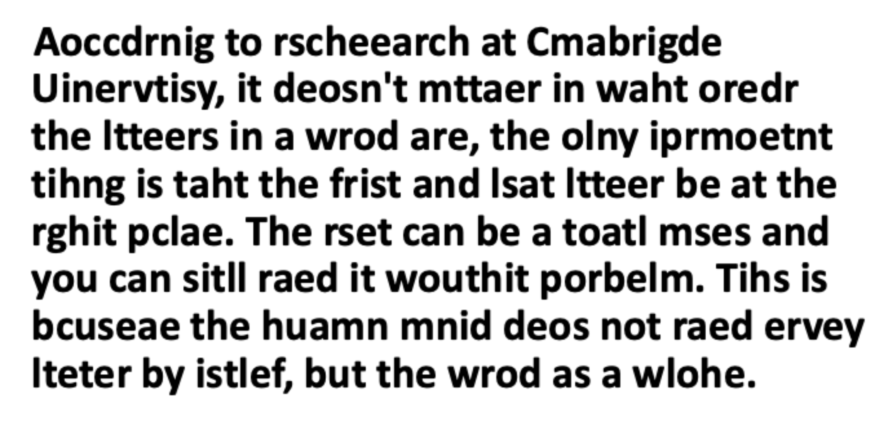
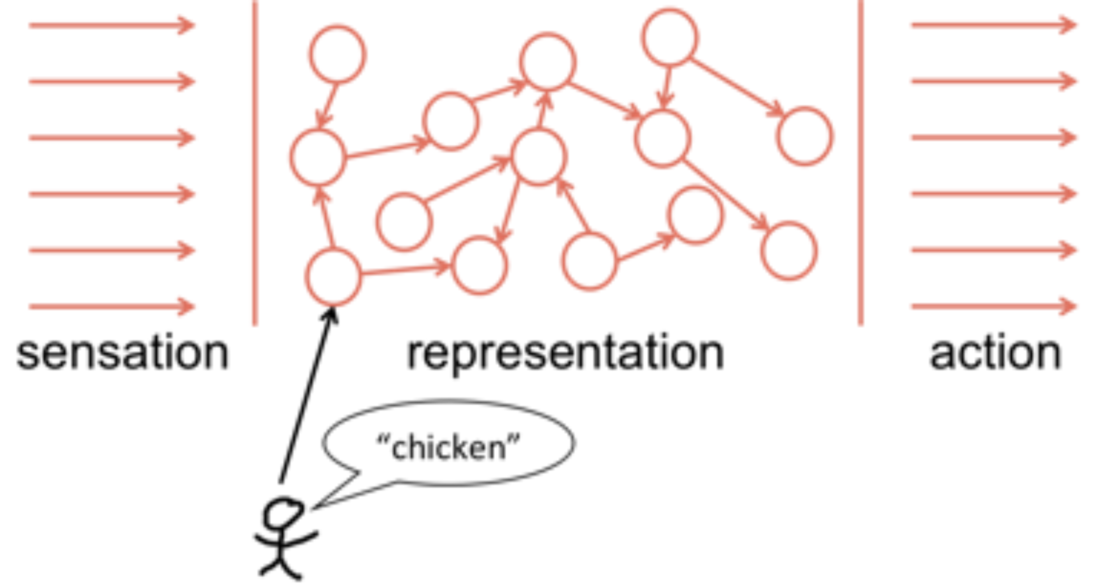
{AI taxonomy}

Slide 9
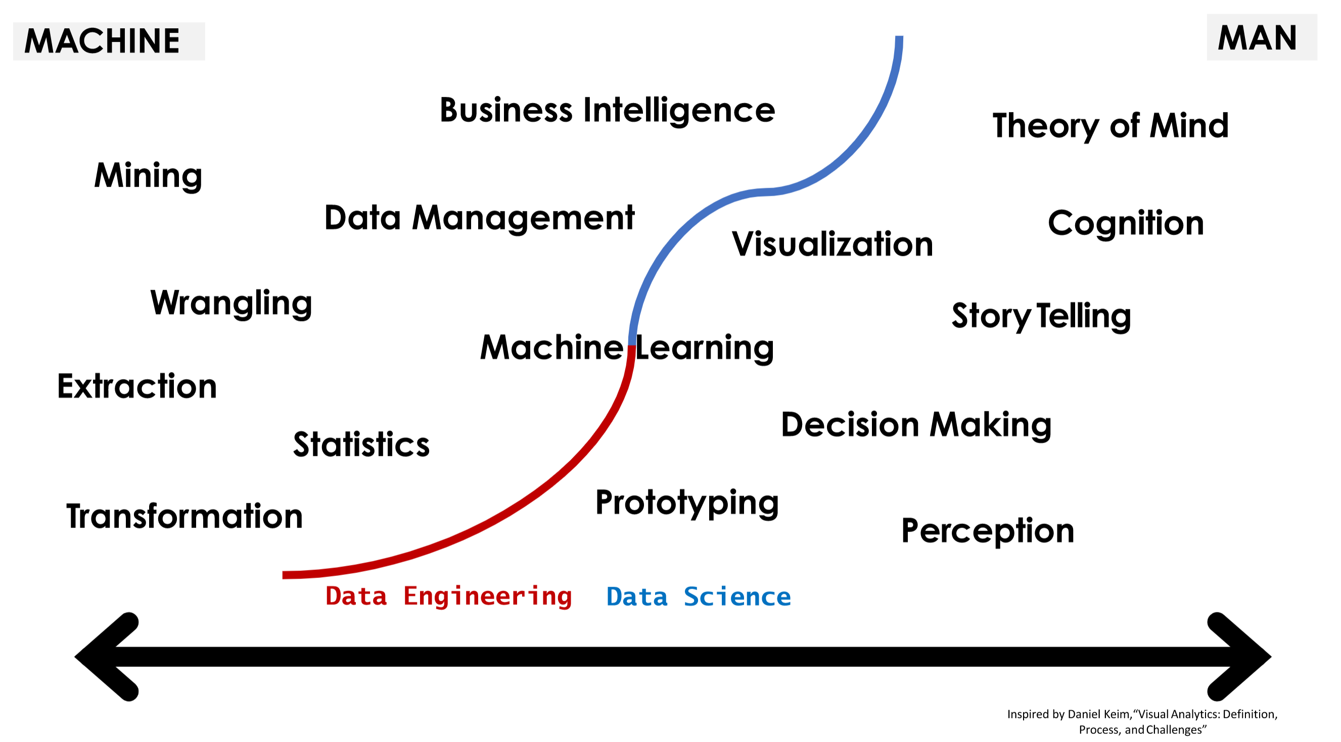
{AI integrates two Scientific Disciplines}
https://robfvdw.medium.com/a-generic-approach-to-data-driven-activities-d85ad558b5fa

Slide 10
{Brute Force}
State-of-the-Art {SOTA} {AI} relies
on a brute-force approach:
to produce cognitive abilities
that are on par with Human-Level Performance.
High-performance GPU or TPU computing power
Black-Box, poorly understood solutions
Training with massive data-sets
Deep Neural Network architecture
Billions of parameters
Lengthy Process & Huge budgets

Slide 11
{Chat-Bot Meena}
https://ai.googleblog.com/2020/01/towards-conversational-agent-that-can.html
https://arxiv.org/pdf/2001.09977.pdf
Google research 2020:
“Meena can chat convincingly about
any topic that is meaningful to humans”
HPC: 2,048 TPU v3 cores, 16GB DDR5 memory
trained on 40 billion words (61B BPE tokens) [341 GB]
Evolved Transformer NAS
32 decoder layers, deep neural network
2.6 [Billion] parameters
30 days of training, 4[Million] tokens per second
Training cost: 1,500,000$
https://cloud.google.com/tpu/pricing

Slide 12
Simple Predicting Machine
What constitutes a
{Deep} Neural Net?

Slide 13
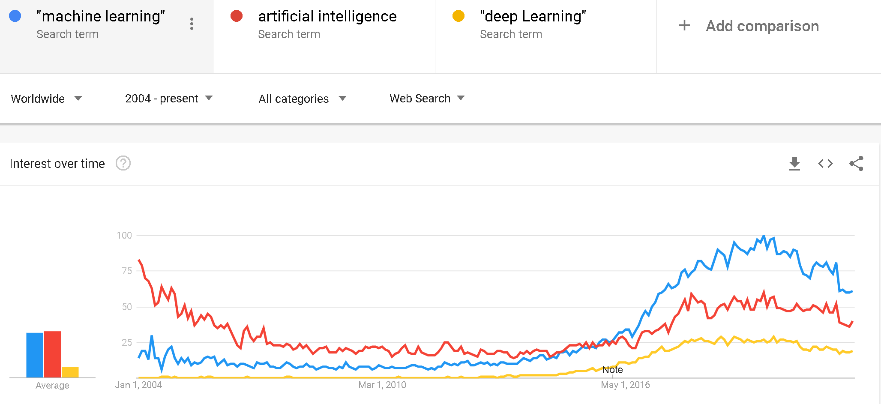
{DL}
(Pre-trained) Deep Learning {DL} Neural Networks {NNs} are the most advanced, successful & fastest growing Artificial Intelligence {AI} technology
https://trends.google.com/trends/explore?date=all&q=%22machine%20learning%22,artificial%20intelligence,%22deep%20Learning%22

Slide 14
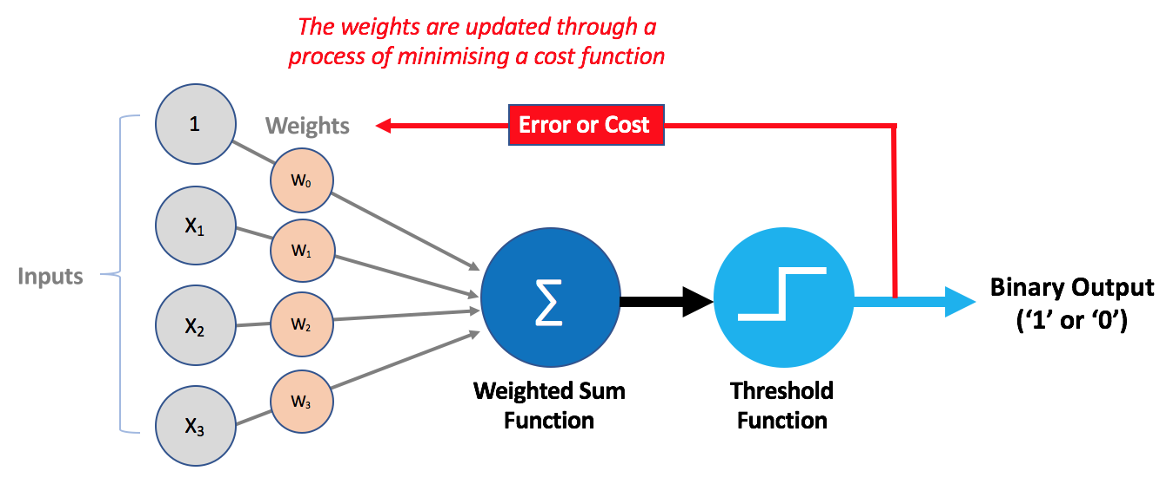
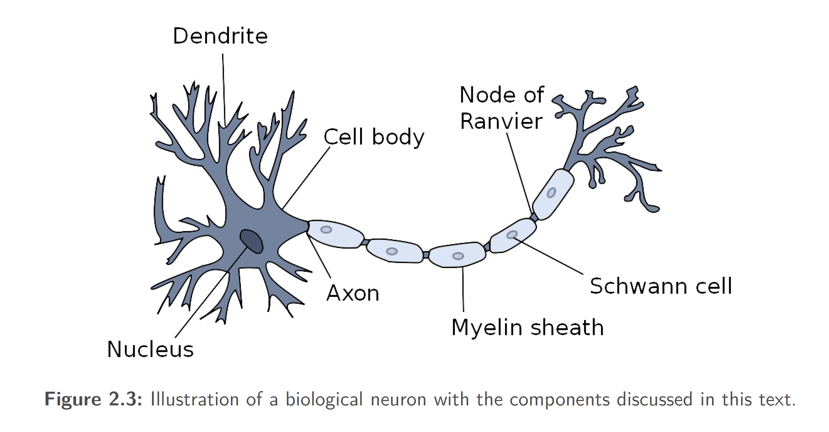
{Artificial Neurons}
Deep Neural Nets {DNNs} harbor vast amounts of
“artificial neurons” ➔smallest computational unit⬅
Names for
Artificial Neurons
{unit}
{cell}
{node}
{perceptron}

Slide 15
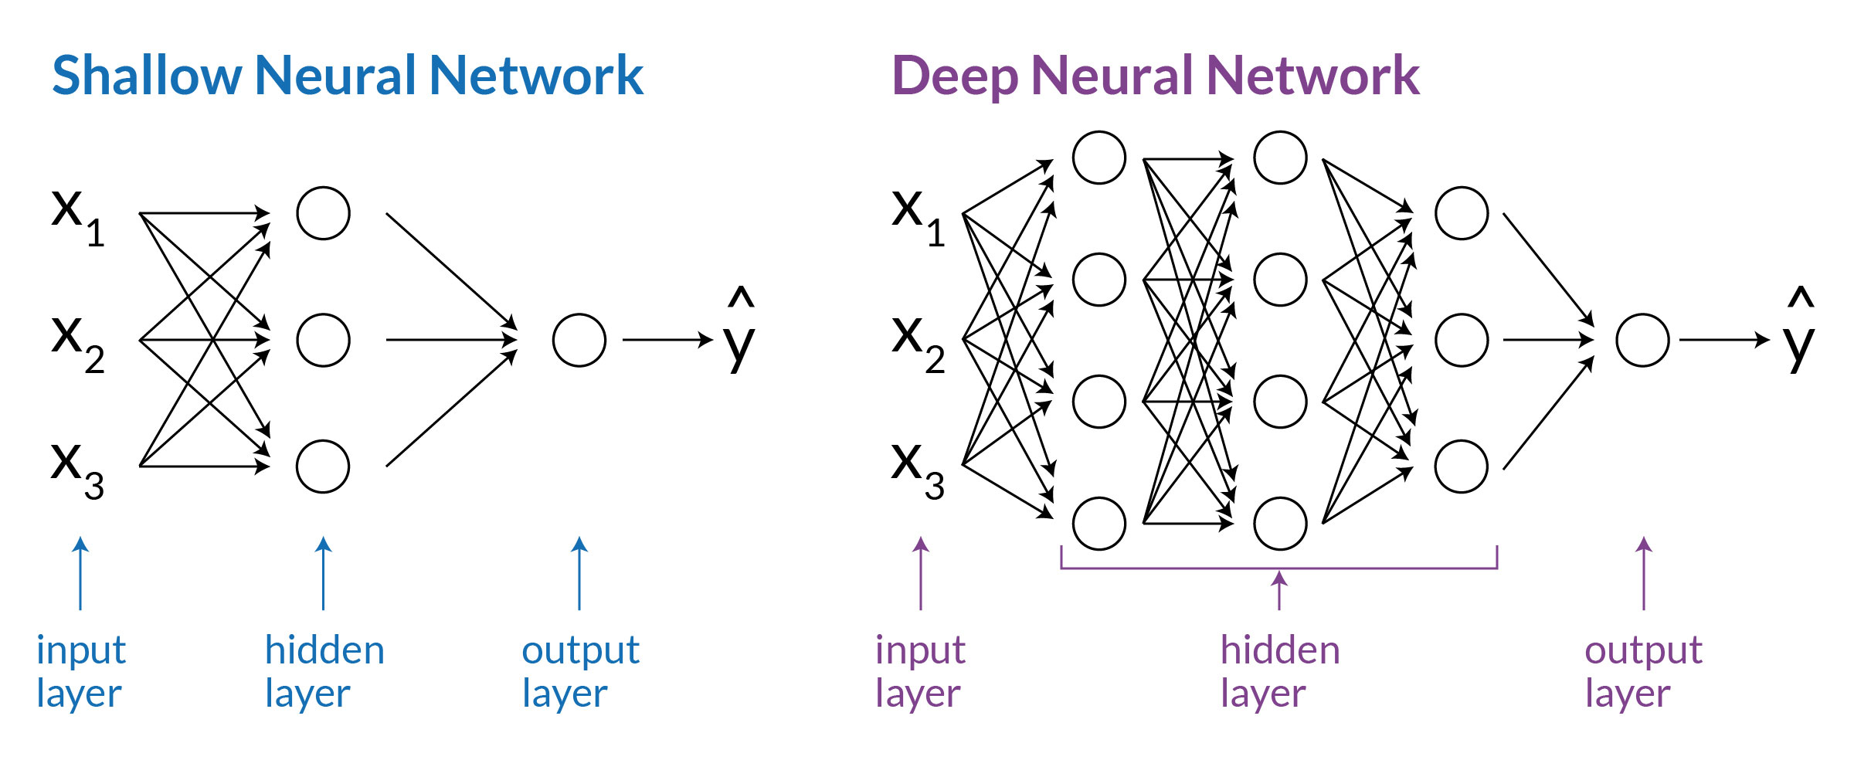
{Layers}
Neural Network {NN} Layer Architecture
Weights
N=12
Weights
N=16
Weights
N=12
Weights
N=3
Weights
N=9
Weights
N=3
Input layer
Output layer
Input layer
Output layer
Hidden layer N=1
hidden layers N>2
Deep network
Shallow network

Slide 16
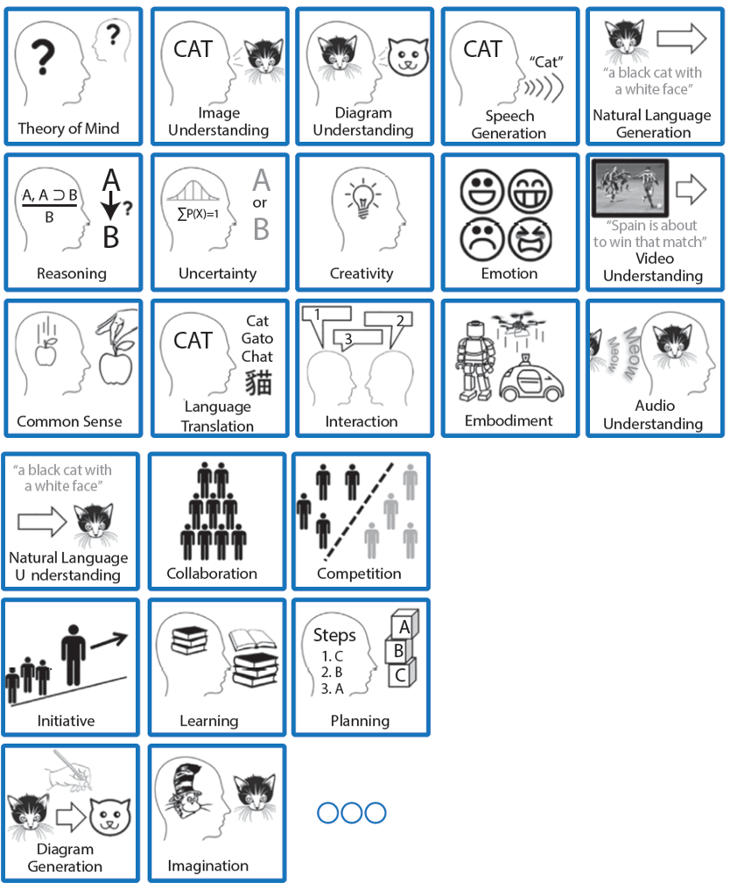

{AI=ML=DL}
https://doi.org/10.1609/aimag.v37i1.2643
AI enabled through {DL} must be understood as any form of
Machine Learning {ML} technology
mimicking & automatizing tasks
which otherwise require
human perception,
cognition and/or
motor skills
https://robfvdw.medium.com/the-world-wide-web-ai-safari-b2e4f7f90647

Slide 17
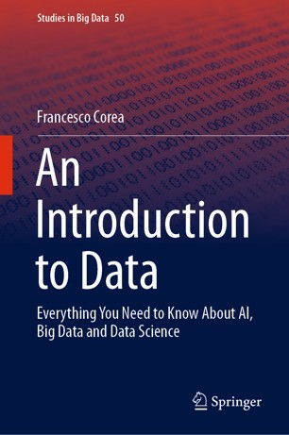
{DL + DNNs}
Deep learning {DL} must be understood as
a major Machine Learning {ML} subdomain:
Crafting Deep Neural Networks {DNNs} that can attain human-level performances on challenging cognitive tasks.
{DNNs} can Recognize Speech or Human Poses & Faces; Translate Text in real time
at High Levels of Performance.

Slide 18
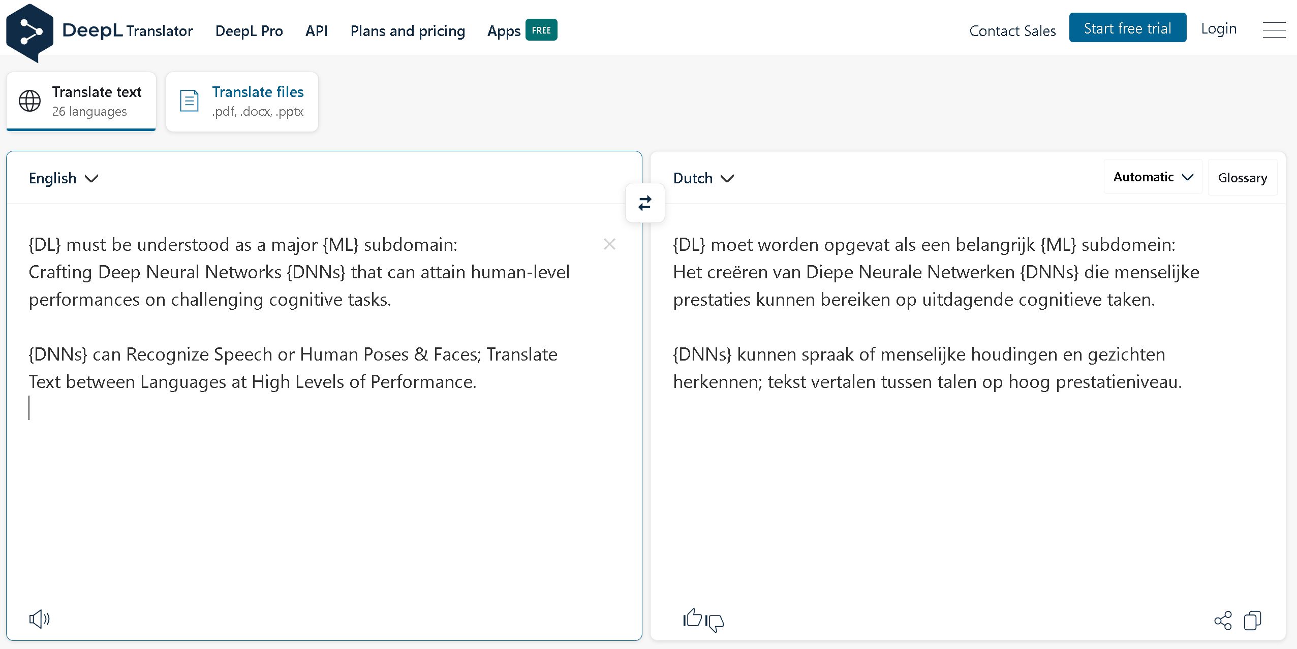
{Human-level performance}
Simple Predicting Machine
https://www.deepl.com/translator

Slide 19
This Lecture
Basic deﬁnitions and concepts. Introduction to the problem of learning.

Slide 21
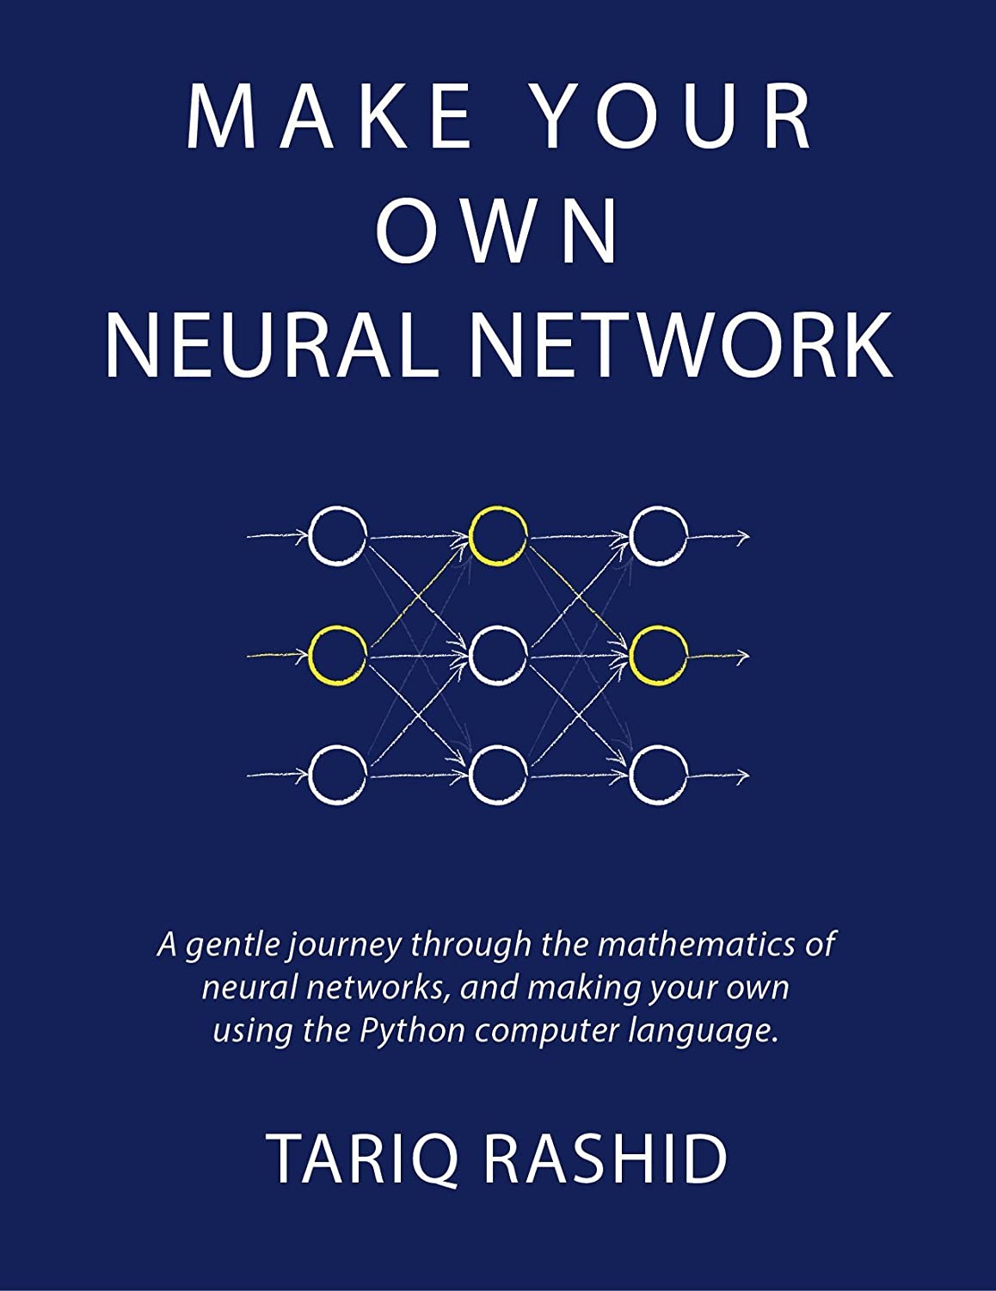
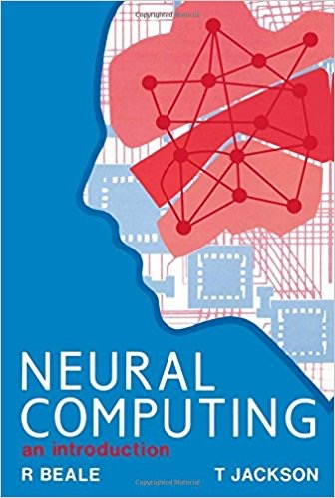

{01}
Fundamentals

Slide 22

Simple Predicting Machine

Slide 23
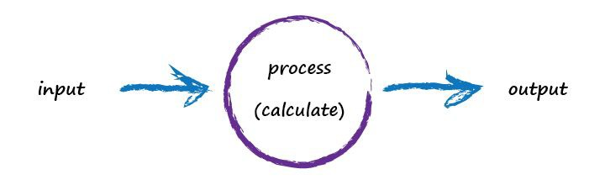
Simple Predicting Machine

Slide 24
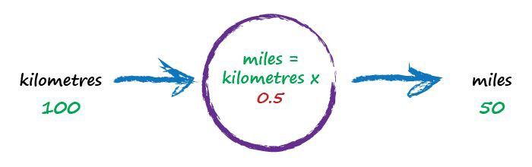
Kilometres to Miles
random starting parameter
try a model - this one is linear

Slide 25
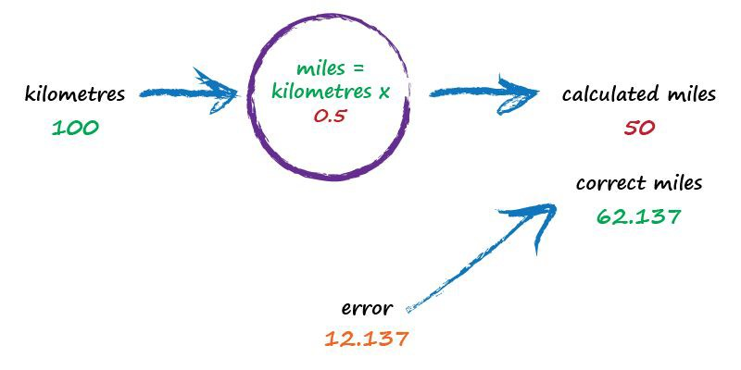
Kilometres to Miles
not great

Slide 26
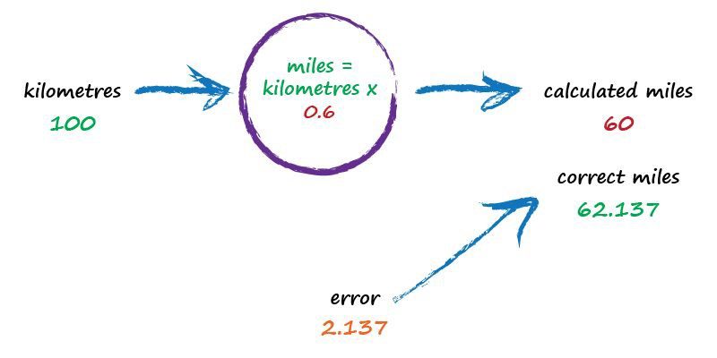
Kilometres to Miles
better

Slide 27
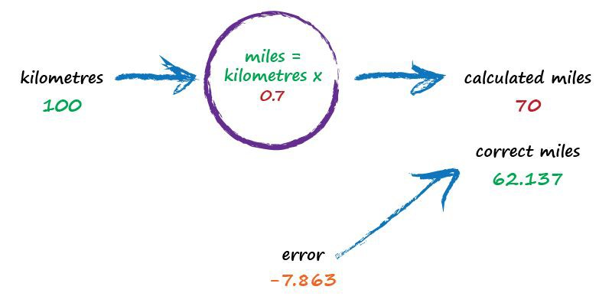
Kilometres to Miles
worse !

Slide 28
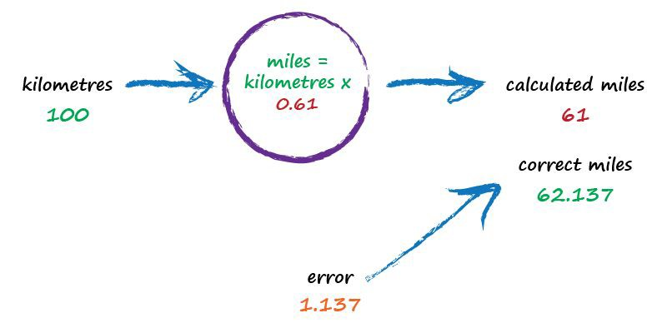
Kilometres to Miles
best yet !

Slide 29

Key Points
_{Don’t} know how something works exactly? Try a
1.
model with adjustable parameters.
_{Use} the error to refine the parameters.
2.

Slide 30
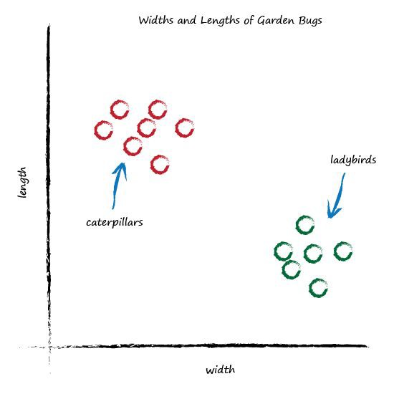
Garden Bugs

Slide 31
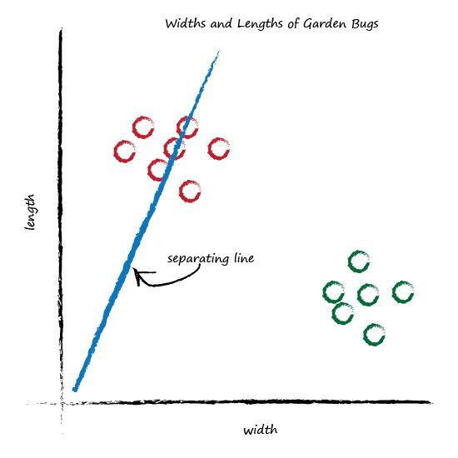
Classifying Bugs

Slide 32
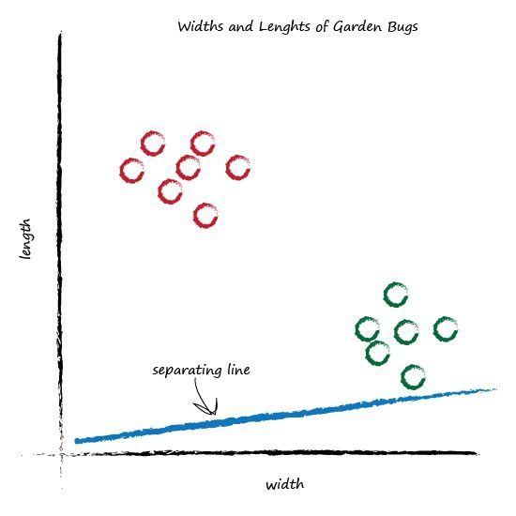
Classifying Bugs

Slide 33
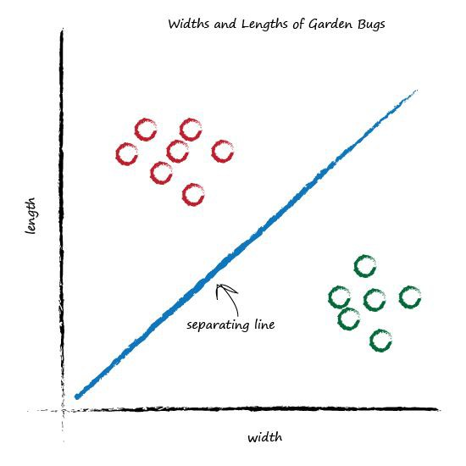
Classifying Bugs

Slide 34
Key Points
_{Classifying} things is kinda like predicting things.
1.

Slide 35
Boolean Logic
IF I have eaten my vegetables AND I am still hungry
THEN I can have ice cream.
IF it’s the weekend OR I am on annual leave THEN I’ll go to the park.
Input A | Input B | AND | OR
0 | 0 | 0 | 0
0 | 1 | 0 | 1
1 | 0 | 0 | 1
1 | 1 | 1 | 1

Slide 36
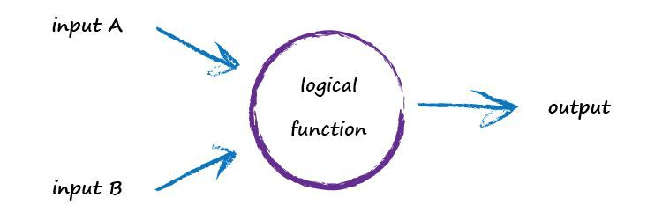
Boolean Logic

Slide 37
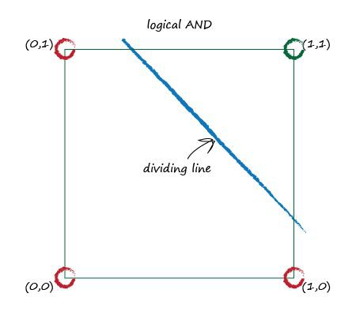
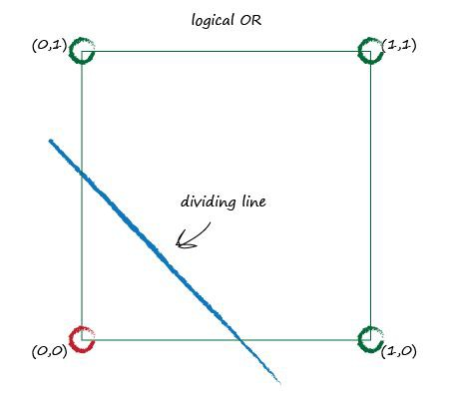
Boolean Logic

Slide 38
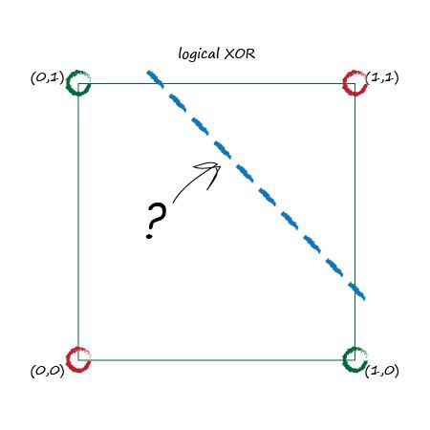
XOR Puzzle!
Input A | Input B | XOR
0 | 0 | 0
0 | 1 | 1
1 | 0 | 1
1 | 1 | 0

Slide 39
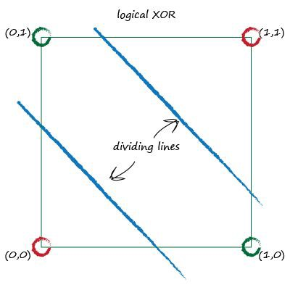
XOR Solution!
… Use more than one node!

Slide 40
Key Points
Some problems can’t be solved with just a single
1.
simple linear classifier.
_{You} can use multiple nodes working together to
2.
solve many of these problems.

Slide 41
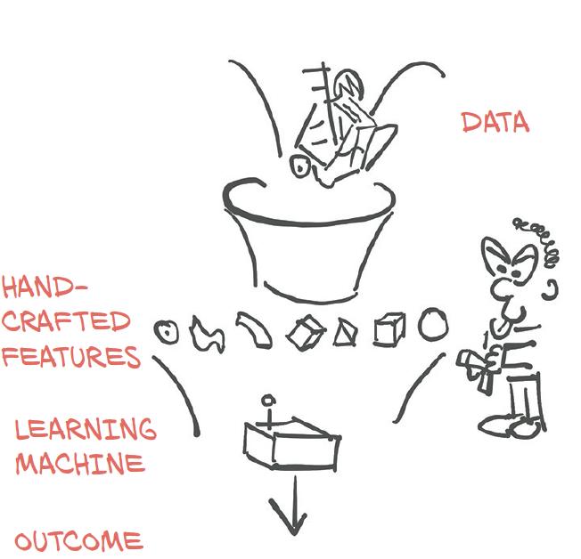
MACHINE LEARNING [ML]

Slide 42
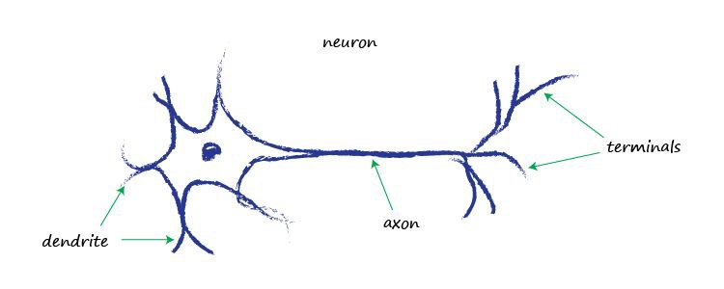
Brains in Nature

Slide 43
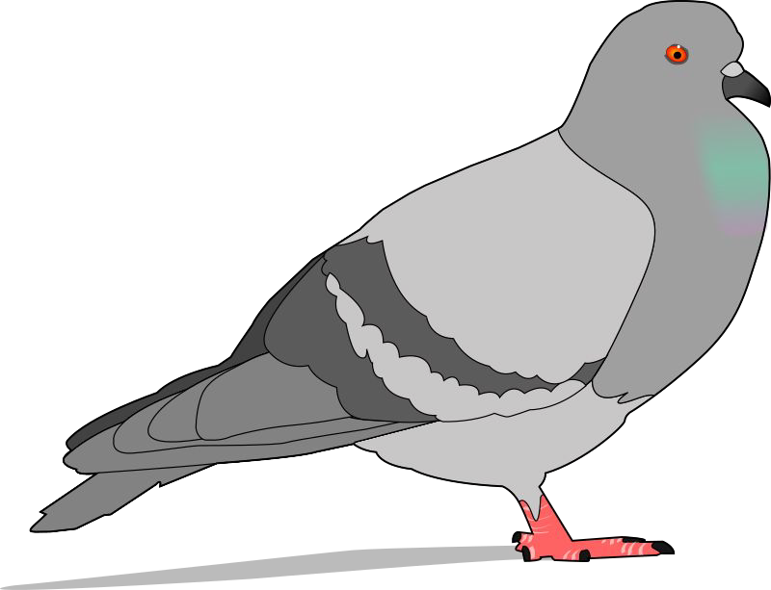
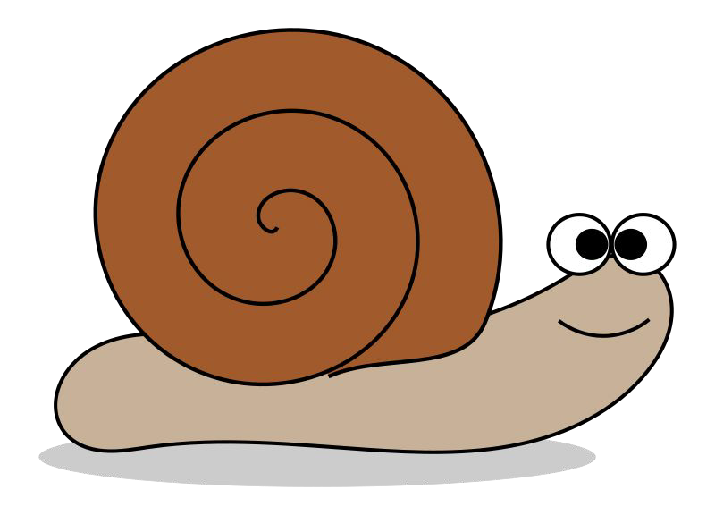


Brains in Nature
brain 0.4 grams
11,000 neurons
nature’s brains can eat, fly, navigate, fight, communicate, play, learn …
.. and they’re resilient
302 neurons
37 billion neurons
(humans 20 billion)

Slide 44
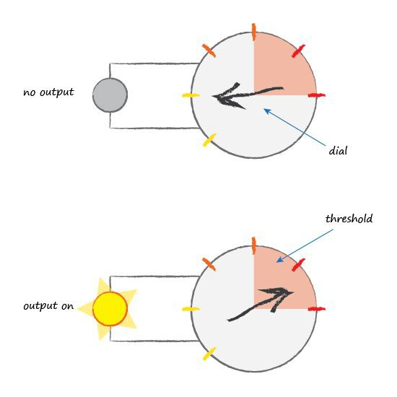
Brains in Nature

Slide 45
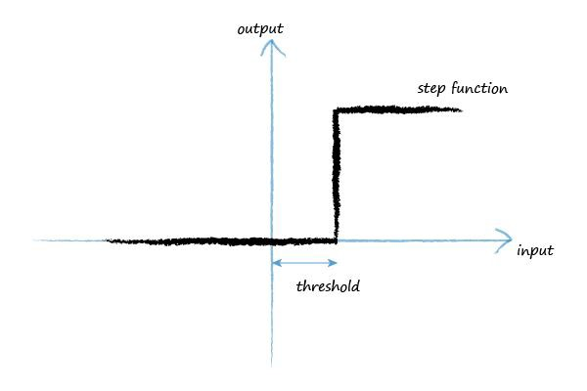
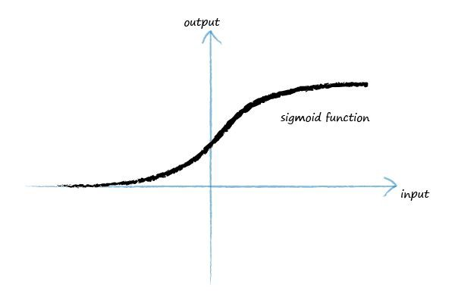
Brains in Nature
logistic function
y = 1 / (1 + e^{-x})

Slide 46
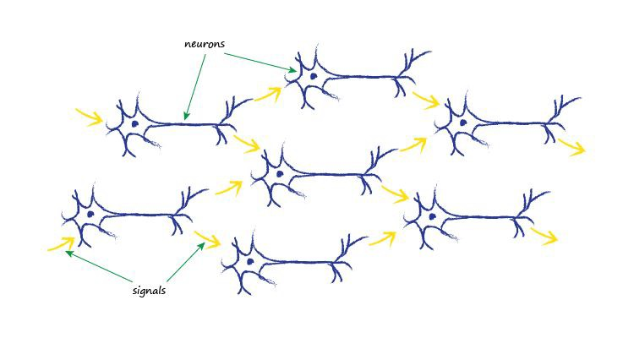
Brains in Nature

Slide 47
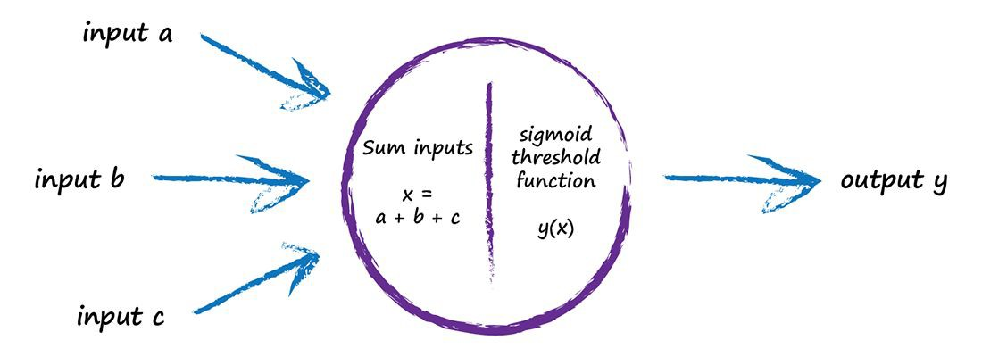
Artificial Neuron

Slide 48
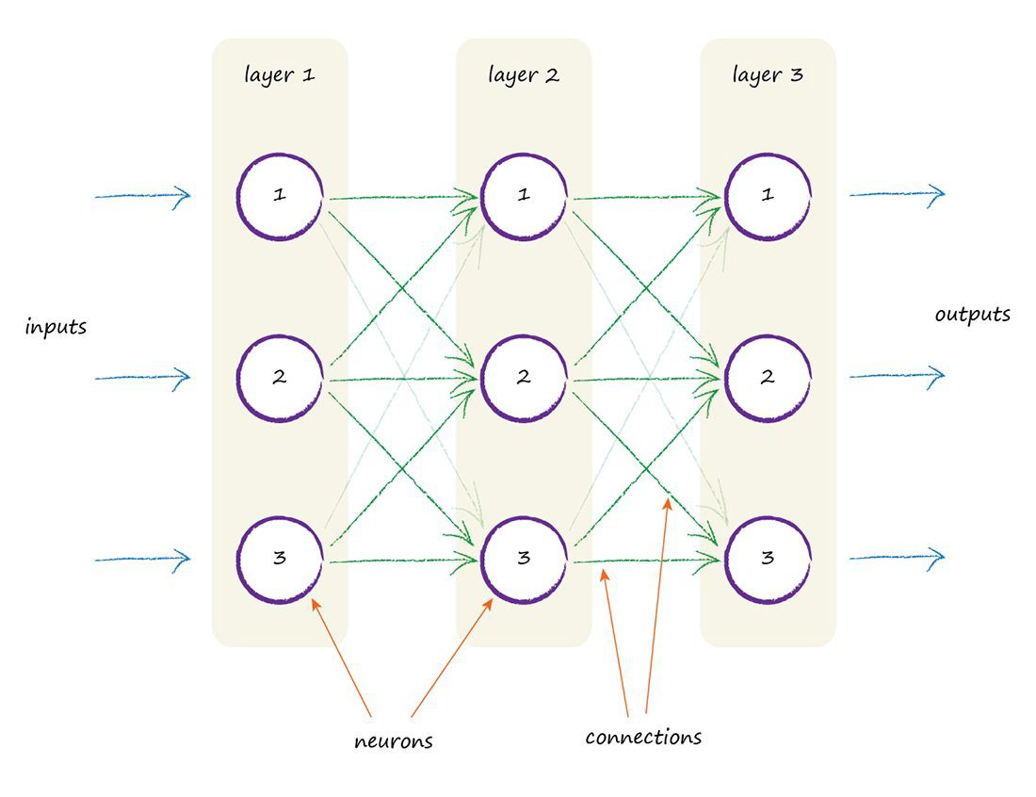
Artificial Neural Network .. finally!

Slide 49

Pause.
...

Slide 50
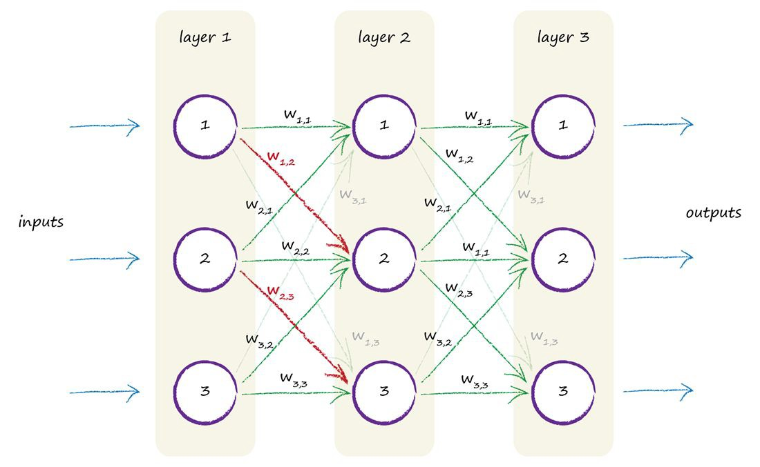
Where Does The Learning Happen?
link weight?
sigmoid function slope?

Slide 51
Key Points
Natural brains can do sophisticated things, ^{and}
1.
are incredibly resilient to damage ^{and imperfect}
signals .. unlike traditional ^{computing.}
Trying to copy biological brains partly inspired
2.
artificial neural networks.
Link weights are the adjustable parameter ^{- it’s}
3.
where the learning happens.

Slide 52
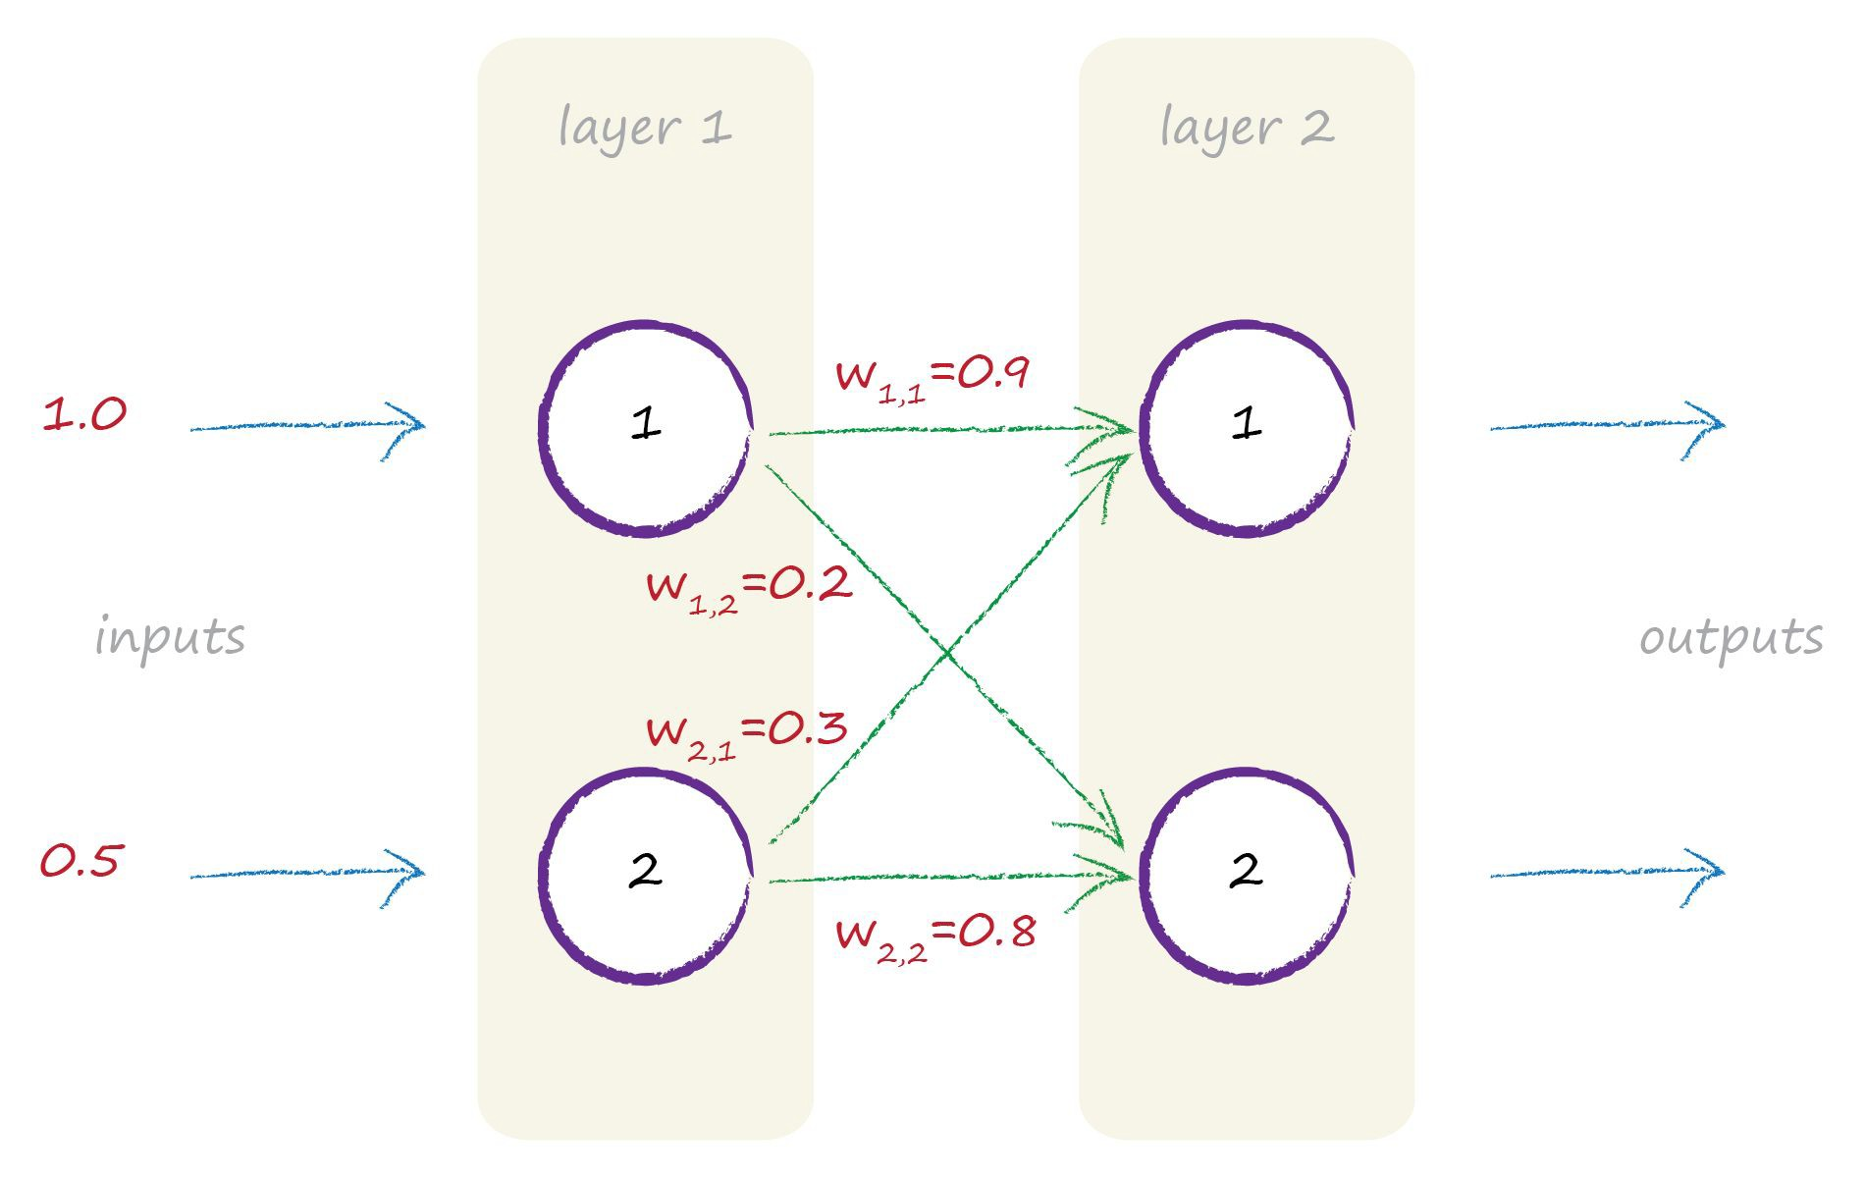
Feeding Signals Forward

Slide 53
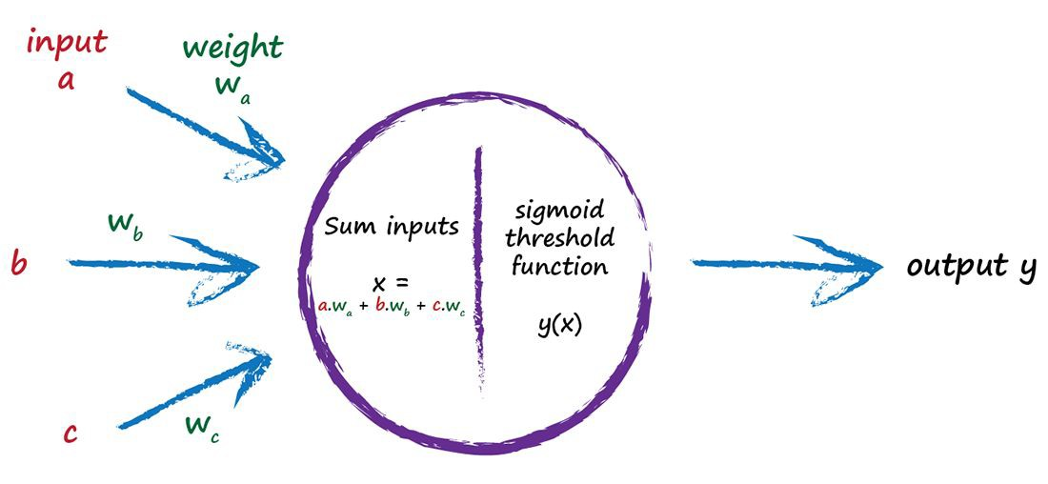
Feeding Signals Forward

Slide 54
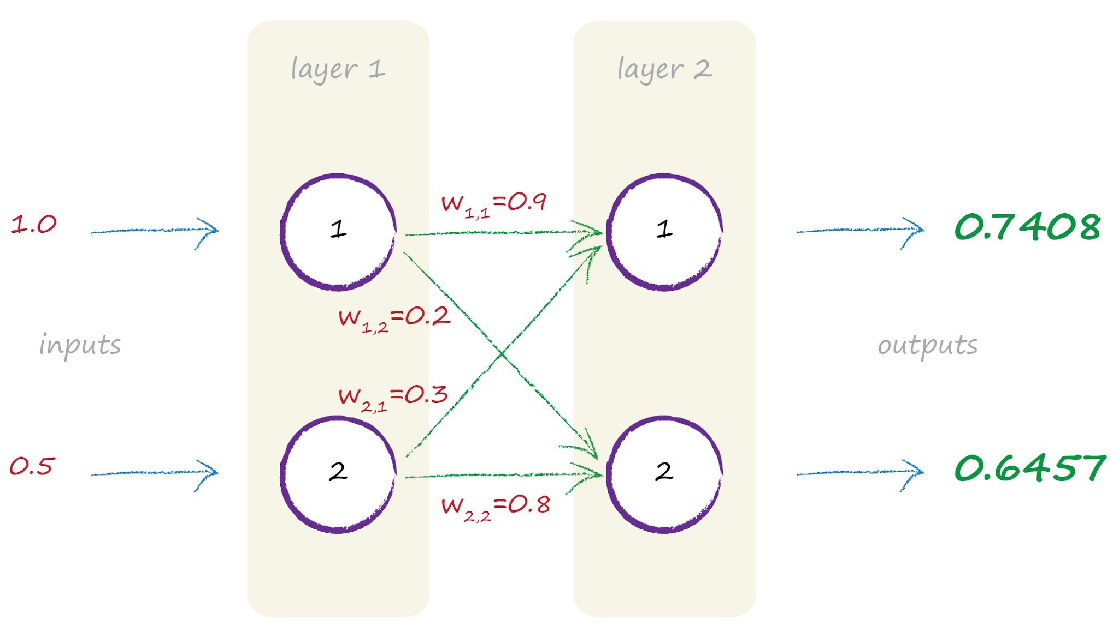
Feeding Signals Forward

Slide 55
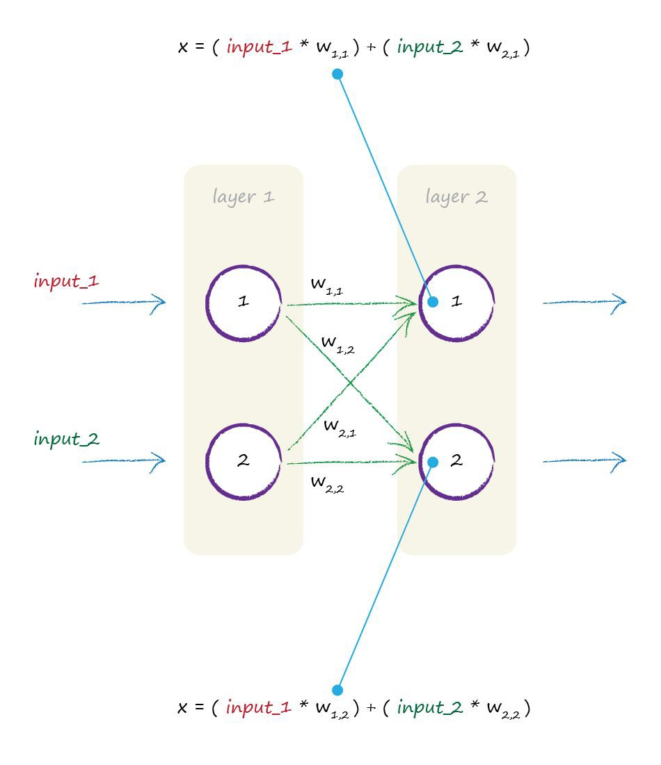
Matrix Multiplication

Slide 56
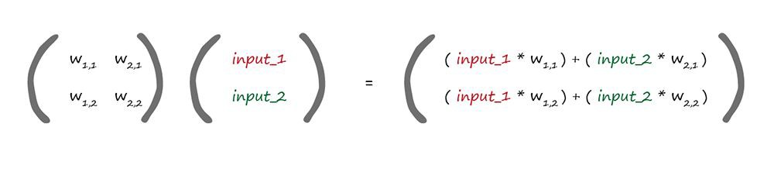
Matrix Multiplication
weights
incoming signals
W · I = X
dot product

Slide 57
Key Points
The many feedforward calculations can be
1.
_{expressed} concisely as matrix multiplication, no
matter what shape the network.
2. Some programming languages can ^{do matrix}
multiplication really efficiently and quickly.

Slide 58
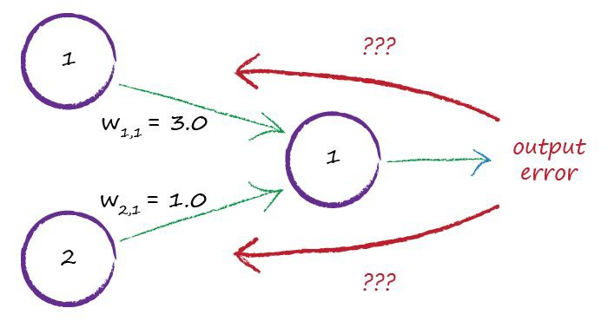
Network Error

Slide 59
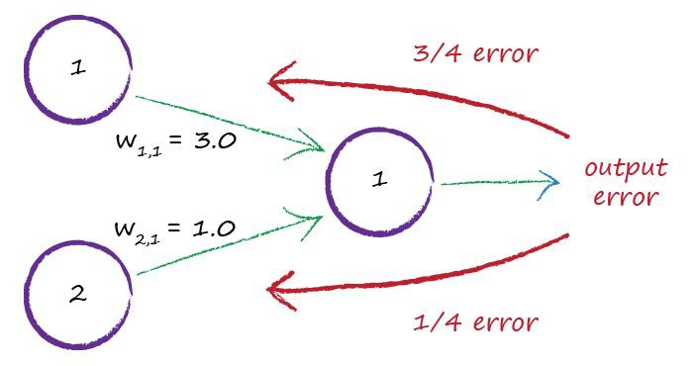
Network Error

Slide 60
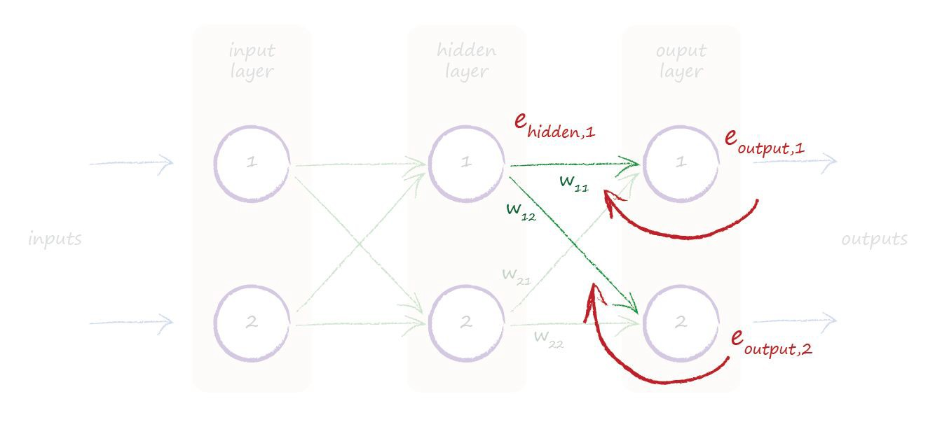
Internal Error

Slide 61
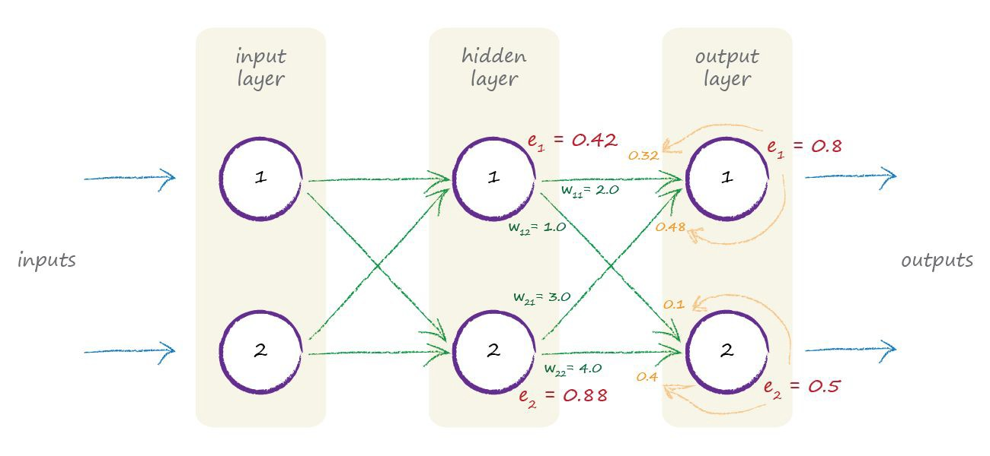
Internal Error

Slide 62
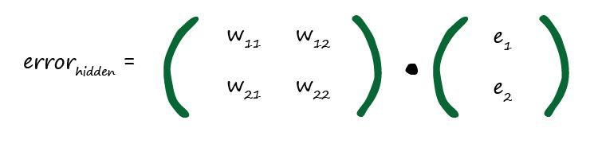

Matrices Again!

Slide 63
Key Points
Remember we use the error to guide how we
1.
refine a model’s parameter ^{- link weights.}
The error at the output nodes is easy - the
2.
difference between the desired ^{and actual}
outputs.
The error at internal nodes isn’t obvious. A
3.
_{heuristic} approach is to split it in proportion to
the link weights.
… and back propagating the error can be
4.
expressed as a matrix multiplication too!

Slide 64

Simple Predicting Machine

Slide 65
Simple Predicting Machine

Slide 66
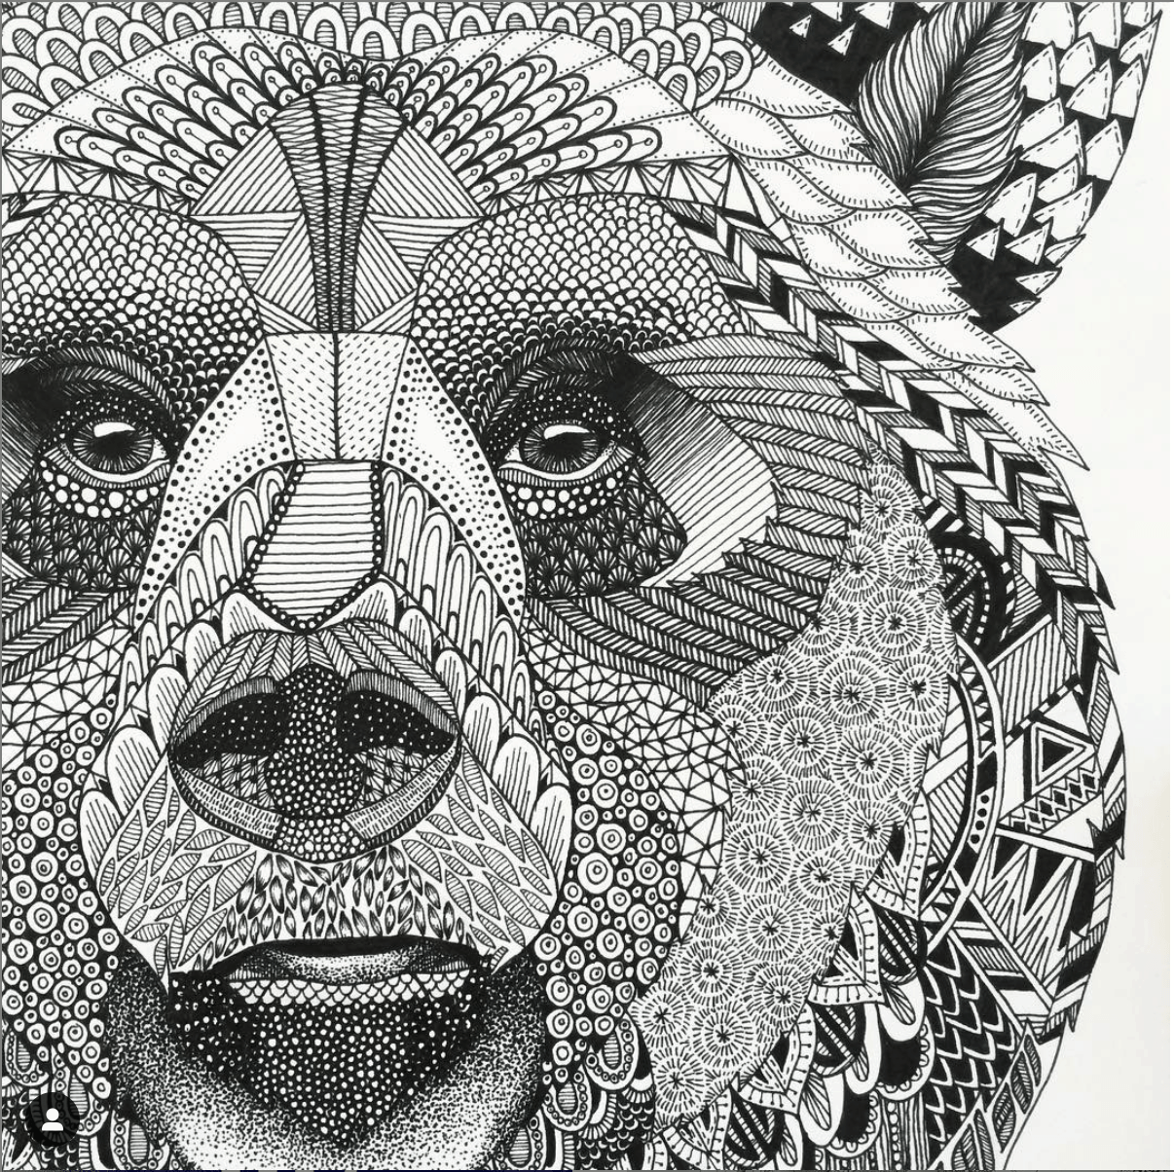
{04}
Do it Yourself

Slide 67
Python Class and Functions
Neural Network Class
Initialise
Train
Query
set size, initial weights
do the learning
query for answers

Slide 68


numpy scipy matplotlib notebook
Python
matrix maths

Slide 69



Function - Initialise
# initialise the neural network
def init (self, inputnodes, hiddennodes, outputnodes, learningrate): # set number of nodes in each input, hidden, output layer self.inodes = inputnodes
self.hnodes = hiddennodes self.onodes = outputnodes
# link weight matrices, wih and who
# weights inside the arrays are w_i_j, where link is from node i to node j in the next layer # w11 w21
# w12 w22 etc
self.wih = numpy.random.normal(0.0, pow(self.hnodes, -0.5), (self.hnodes, self.inodes)) self.who = numpy.random.normal(0.0, pow(self.onodes, -0.5), (self.onodes, self.hnodes))
# learning rate
self.lr = learningrate
# activation function is the sigmoid function
self.activation_function = lambda x: scipy.special.expit(x)
pass
numpy.random.normal()
random initial weights

Slide 70

Function - Query
combined weighted signals into hidden layer
then sigmoid applied
# query the neural network
def query(self, inputs_list):
# convert inputs list to 2d array
inputs = numpy.array(inputs_list, ndmin=2).T
# calculate signals into hidden layer
hidden_inputs = numpy.dot(self.wih, inputs)
# calculate the signals emerging from hidden layer
hidden_outputs = self.activation_function(hidden_inputs)
# calculate signals into final output layer
final_inputs = numpy.dot(self.who, hidden_outputs)
# calculate the signals emerging from final output layer
final_outputs = self.activation_function(final_inputs)
return final_outputs
numpy.dot()
similar for output layer

Slide 71
Function - Train
# train the neural network
def train(self, inputs_list, targets_list):
# convert inputs list to 2d array
inputs = numpy.array(inputs_list, ndmin=2).T targets = numpy.array(targets_list, ndmin=2).T
same feed forward as before
# calculate signals into hidden layer
hidden_inputs = numpy.dot(self.wih, inputs)
# calculate the signals emerging from hidden layer
hidden_outputs = self.activation_function(hidden_inputs)
# calculate signals into final output layer
final_inputs = numpy.dot(self.who, hidden_outputs)
# calculate the signals emerging from final output layer
final_outputs = self.activation_function(final_inputs)
output layer errors
hidden layer errors
# output layer error is the (target - actual)
output_errors = targets - final_outputs
# hidden layer error is the output_errors, split by weights, recombined at hidden nodes
hidden_errors = numpy.dot(self.who.T, output_errors)
# update the weights for the links between the hidden and output layers
self.who += self.lr * numpy.dot((output_errors * final_outputs * (1.0 - final_outputs)), numpy.transpose(hidden_outputs))
# update the weights for the links between the input and hidden layers
self.wih += self.lr * numpy.dot((hidden_errors * hidden_outputs * (1.0 - hidden_outputs)), numpy.transpose(inputs))
pass
update weights

Slide 72



This lesson was developed by:
Robert Frans van der Willigen
CMD, Hogeschool Rotterdam
OKT 2020
http://creativecommons.org/licenses/by-nc-sa/3.0/
This lesson is licensed under a Creative Commons Attribution-Share-Alike license. You can change it, transmit it, show it to other people. Just always give credit to RFvdW.
http://empoweringthenatives.edublogs.org/2012/03/15/creative-commons-licenses/
http://creativecommons.org/licenses/

